Slide 1
Distributed Operating Systems - Introduction
Prof. Nalini Venkatasubramanian
(includes slides borrowed from Prof. Petru Eles, lecture slides from Coulouris, Dollimore and Kindberg textbook)

Slide 2
What does an OS do?
Process/Thread Management
  Scheduling
  Communication
  Synchronization
Memory Management
Storage Management
FileSystems Management
Protection and Security
Networking

Slide 3
Distributed Operating Systems
Manages a collection of independent computers and makes them appear to the users of the system as if it were a single computer
Multiprocessors
  Tightly coupled
  Shared memory
Multicomputers
  Loosely coupled
  Private memory
  Autonomous
Memory
CPU
CPU
CPU
CPU
CPU
Memory
Memory
Memory
Cache
Cache
Parallel Architecture
Distributed Architecture

Slide 4
Workstation Model
How to find an idle workstation?
How is a process transferred from one workstation to another?
What happens to a remote process if a user logs onto a workstation that was idle, but is no longer idle now?
Other models - processor pool, workstation server...
ws1
ws1
ws1
Communication Network
ws1
ws1

Slide 5
Distributed Operating System (DOS) Types
Distributed OSs vary based on
    System Image
    Autonomy
    Fault Tolerance Capability
Multiprocessor OS
    Looks like a virtual uniprocessor, contains only one copy of the OS, communicates via shared memory, single run queue
Network OS
    Does not look like a virtual uniprocessor, contains n copies of the OS, communicates via shared files, n run queues
Distributed OS
    Looks like a virtual uniprocessor (more or less), contains n copies of the OS, communicates via messages, n run queues

Slide 6
Design Issues
Transparency
Performance
Scalability
Reliability
Flexibility (Micro-kernel architecture)
  IPC mechanisms, memory management, Process management/scheduling, low level I/O
Heterogeneity
Security

Slide 7
Design Issues (cont.)
Transparency
  Location transparency
    processes, cpu’s and other devices, files
  Replication transparency (of files)
  Concurrency transparency
    (user unaware of the existence of others)
  Parallelism
    User writes serial program, compiler and OS do the rest
Performance
  Throughput - response time
  Load Balancing (static, dynamic)
  Communication is slow compared to computation speed
    fine grain, coarse grain parallelism

Slide 8
Design Elements
Process Management
  Task Partitioning, allocation, load balancing, migration
Communication
  Two basic IPC paradigms used in DOS
    Message Passing (RPC) and Shared Memory
  synchronous, asynchronous
FileSystems
  Naming of files/directories
  File sharing semantics
  Caching/update/replication

Slide 9
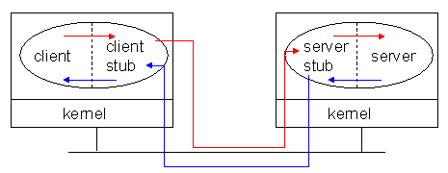
Remote Procedure Call
A convenient way to construct a client-server connection without explicitly writing send/ receive type programs (helps maintain transparency).
Initiated by Birrell and Nelson in 1980’s
Basis of 2 tier client/server systems

Slide 10
Remote Procedure Calls (RPC)
General message passing model for execution of remote functionality.
  Provides programmers with a familiar mechanism for building distributed applications/systems
Familiar semantics (similar to LPC)
  Simple syntax, well defined interface, ease of use, generality and IPC between processes on same/different machines.
It is generally synchronous
Can be made asynchronous by using multi-threading
Caller Process
Request Message
(contains Remote
Procedure’s parameters)
Receive request
(procedure
executes)
Send reply and
wait
For next message
Resume
Execution
Reply Message
( contains result of procedure
execution)

Slide 11
RPC Needs and challenges
Needs – Syntactic and Semantic Transparency
  Resolve differences in data representation
  Support a variety of execution semantics
  Support multi-threaded programming
  Provide good reliability
  Provide independence from transport protocols
  Ensure high degree of security
  Locate required services across networks
Challenges
  Unfortunately achieving exactly the same semantics for RPCs and LPCs is close to impossible
    Disjoint address spaces
    More vulnerable to failure
    Consume more time (mostly due to communication delays)

Slide 12
Implementing RPC Mechanism
Uses the concept of stubs; A perfectly normal LPC abstraction by concealing from programs the interface to the underlying RPC
Involves the following elements
  The client
  The client stub
  The RPC runtime
  The server stub
  The server

Slide 13
RPC – How it works II
client process
server process
client
procedure call
server
procedure
dispatcher
selects stub
server stub
(un)marshal
(de)serialize
receive (send)
client stub
locate
(un)marshal
(de)serialize
send (receive)
communication module
communication module
Wolfgang Gassler, Eva Zangerle

Slide 14
Remote Procedure Call (cont.)
Client procedure calls the client stub in a normal way
Client stub builds a message and traps to the kernel
Kernel sends the message to remote kernel
Remote kernel gives the message to server stub
Server stub unpacks parameters and calls the server
Server computes results and returns it to server stub
Server stub packs results in a message and traps to kernel
Remote kernel sends message to client kernel
Client kernel gives message to client stub
Client stub unpacks results and returns to client

Slide 15
RPC - binding
Static binding
  hard coded stub
    Simple, efficient
    not flexible
  stub recompilation necessary if the location of the server changes
  use of redundant servers not possible
Dynamic binding
  name and directory server
    load balancing
  IDL used for binding
  flexible
  redundant servers possible

Slide 16
RPC - dynamic binding
client process
server process
client
procedure call
server
procedure
3
13
11
10
client stub
bind
(un)marshal
(de)serialize
Find/bind
send
receive
8
server stub
register
(un)marshal
(de)serialize
receive
send
communication module
1
communication module
dispatcher
selects stub
12
4
9
7
12
12
5
6
2
name and directory server
Wolfgang Gassler, Eva Zangerle

Slide 17
RPC - Extensions
conventional RPC: sequential
execution of routines
client blocked until response of server
asynchronous RPC – non blocking
  client has two entry points(request and response)
  server stores result in shared memory
  client picks it up from there

Slide 18
RPC servers and protocols…
RPC Messages (call and reply messages)
Server Implementation
  Stateful servers
  Stateless servers
Communication Protocols
  Request(R)Protocol
  Request/Reply(RR) Protocol
  Request/Reply/Ack(RRA) Protocol
RPC Semantics
  At most once (Default)
  Idempotent: at least once, possibly many times
  Maybe semantics - no response expected (best effort execution)

Slide 19
How Stubs are Generated
Through a compiler
  e.g. DCE/CORBA IDL – a purely declarative language
  Defines only types and procedure headers with familiar syntax (usually C)
It supports
  Interface definition files (.idl)
  Attribute configuration files (.acf)
Uses Familiar programming language data typing
Extensions for distributed programming are added

Slide 20
RPC - IDL Compilation - result
development
environment
client process
server process
IDL
client code
IDL
sources
server code
language specific call interface
IDL compiler
language specific call interface
client stub
server stub
interface
headers
Wolfgang Gassler, Eva Zangerle

Slide 21
RPC NG: DCOM & CORBA
Object models allow services and functionality to be called from distinct processes
DCOM/COM+(Win2000) and CORBA IIOP extend this to allow calling services and objects on different machines
More OS features (authentication,resource management,process creation,…) are being moved to distributed objects.

Slide 22
Sample RPC Middleware Products
JaRPC (NC Laboratories)
  libraries and development system provides the tools to develop ONC/RPC and extended .rpc Client and Servers in Java
powerRPC (Netbula)
  RPC compiler plus a number of library functions. It allows a C/C++ programmer to create powerful ONC RPC compatible client/server and other distributed applications without writing any networking code.
Oscar Workbench (Premier Software Technologies)
  An integration tool. OSCAR, the Open Services Catalog and Application Registry is an interface catalog. OSCAR combines tools to blend IT strategies for legacy wrappering with those to exploit new technologies (object oriented, internet).
NobleNet (Rogue Wave)
  simplifies the development of business-critical client/server applications, and gives developers all the tools needed to distribute these applications across the enterprise. NobleNet RPC automatically generates client/server network code for all program data structures and application programming interfaces (APIs)— reducing development costs and time to market.
NXTWare TX (eCube Systems)
  Allows DCE/RPC-based applications to participate in a service-oriented architecture. Now companies can use J2EE, CORBA (IIOP) and SOAP to securely access data and execute transactions from legacy applications. With this product, organizations can leverage their current investment in existing DCE and RPC applications

Slide 23
Distributed Shared Memory (DSM)
Tightly coupled systems
Use of shared memory for IPC is natural
Distributed Shared Memory
(exists only virtually)
CPU1
Memory
CPU1
Memory
CPU1
Memory
Memory
CPU n
CPU n
…
CPU n
Loosely coupled
distributed-memory processors
Use DSM – distributed shared memory
A middleware solution that provides a shared-memory abstraction.
MMU
MMU
MMU
Node 1
Node n
Communication Network

Slide 24
Issues in designing DSM
Synchronization
Granularity of the block size
Memory Coherence (Consistency models)
Data Location and Access
Replacement Strategies
Thrashing
Heterogeneity

Slide 25
Synchronization
Inevitable in Distributed Systems where distinct processes are running concurrently and sharing resources.
Synchronization related issues
  Clock synchronization/Event Ordering (recall happened before relation)
  Mutual exclusion
  Deadlocks
  Election Algorithms

Slide 26
Distributed Mutual Exclusion
Mutual exclusion
    ensures that concurrent processes have serialized access to shared resources - the critical section problem
  Shared variables (semaphores) cannot be used in a distributed system
      Mutual exclusion must be based on message passing, in the context of unpredictable delays and incomplete knowledge
    In some applications (e.g. transaction processing) the resource is managed by a server which implements its own lock along with mechanisms to synchronize access to the resource.

Slide 27
Distributed Mutual Exclusion
Basic requirements
  Safety
    At most one process may execute in the critical section (CS) at a time
  Liveness
    A process requesting entry to the CS is eventually granted it (as long as any process executing in its CS eventually leaves it.
    Implies freedom from deadlock and starvation

Slide 28
Mutual Exclusion Techniques
Non-token Based Approaches
  Each process freely and equally competes for the right to use the shared resource; requests are arbitrated by a central control suite or by distributed agreement
    Central Coordinator Algorithm
    Ricart-Agrawala Algorithm
Token-based approaches
  A logical token representing the access right to the shared resource is passed in a regulated fachion among processes; whoever holds the token is allowed to enter the critical section.
    Token Ring Algorithm
    Ricart-Agrawala Second Algorithm

Slide 29
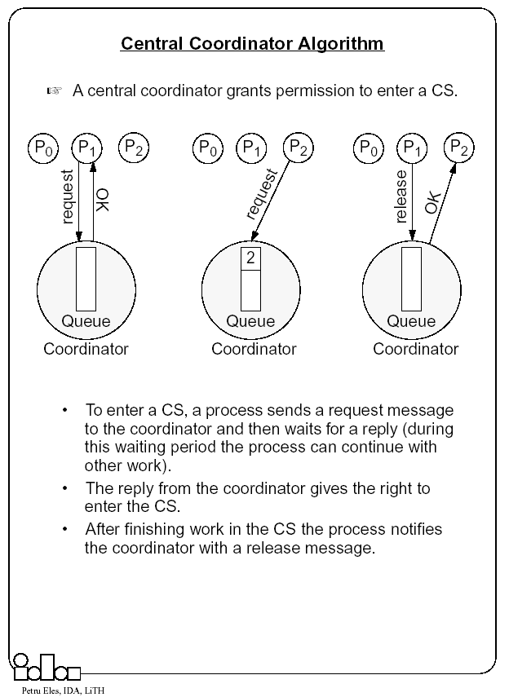

Slide 30
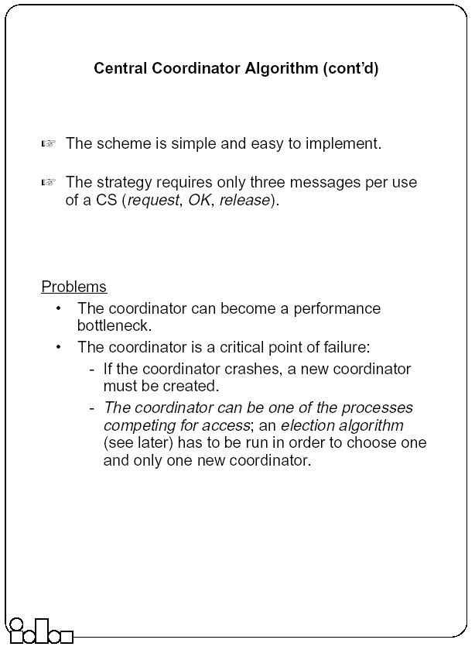

Slide 31
Ricart-Agrawala Algorithm
In a distributed environment it seems more natural to implement mutual exclusion, based upon distributed agreement - not on a central coordinator.
It is assumed that all processes keep a (Lamport’s) logical clock which is updated according to the clock rules.
  The algorithm requires a total ordering of requests. Requests are ordered according to their global logical timestamps; if timestamps are equal, process identifiers are compared to order them.
The process that requires entry to a CS multicasts the request message to all other processes competing for the same resource.
  Process is allowed to enter the CS when all processes have replied to this message.
  The request message consists of the requesting process’ timestamp (logical clock) and its identifier.
Each process keeps its state with respect to the CS: released, requested, or held.

Slide 32
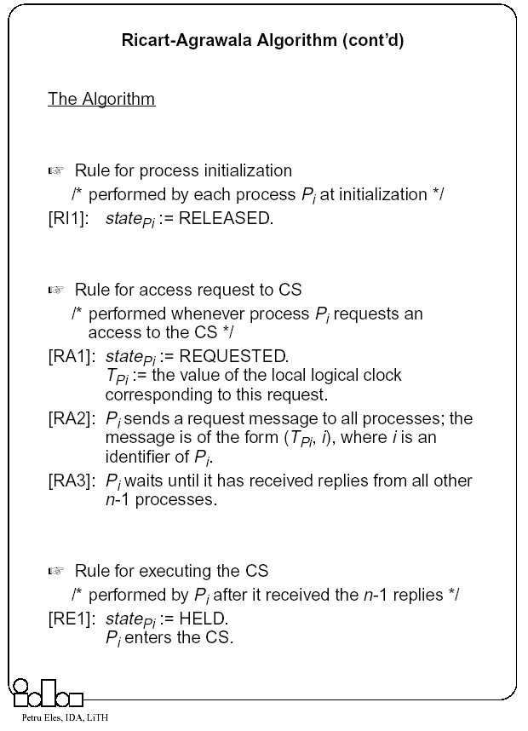

Slide 33
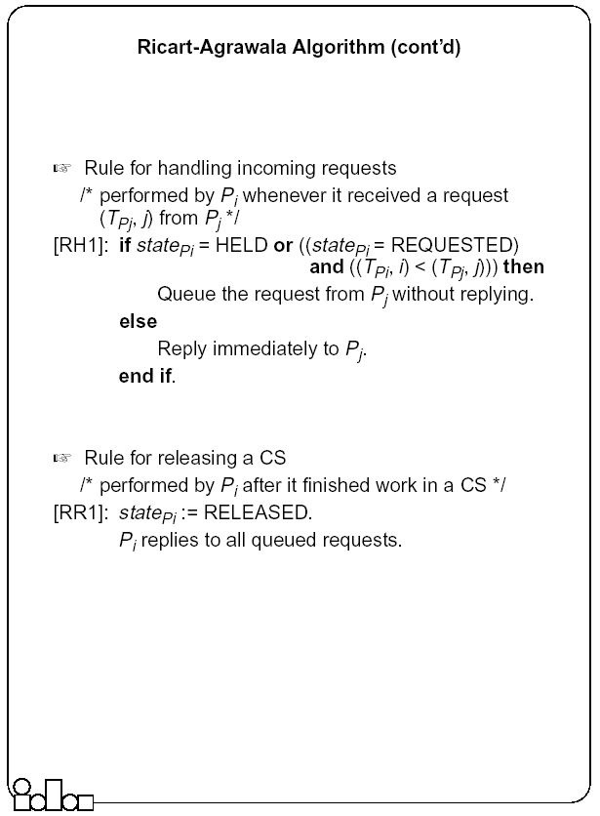

Slide 34
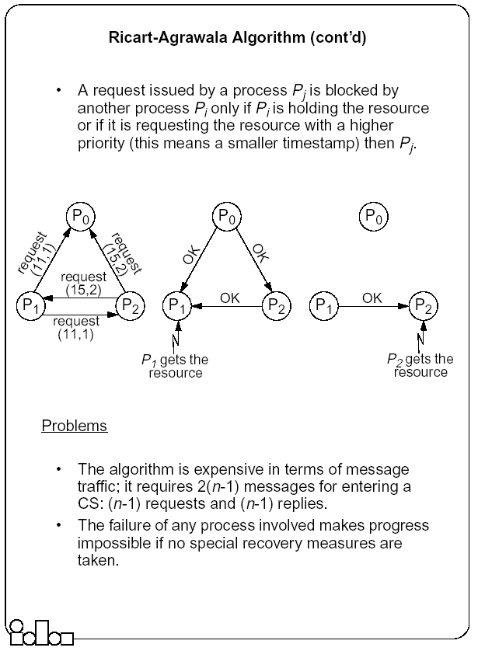

Slide 35
Token-Based Mutual Exclusion
• Ricart-Agrawala Second Algorithm
• Token Ring Algorithm

Slide 36
Ricart-Agrawala Second Algorithm
A process is allowed to enter the critical section when it gets the token.
  Initially the token is assigned arbitrarily to one of the processes.
In order to get the token it sends a request to all other processes competing for the same resource.
  The request message consists of the requesting process’ timestamp (logical clock) and its identifier.
When a process Pi leaves a critical section
  it passes the token to one of the processes which are waiting for it; this will be the first process Pj, where j is searched in order [ i+1, i+2, ..., n, 1, 2, ..., i-2, i-1] for which there is a pending request.
  If no process is waiting, Pi retains the token (and is allowed to enter the CS if it needs); it will pass over the token as result of an incoming request.
How does Pi find out if there is a pending request?
  Each process Pi records the timestamp corresponding to the last request it got from process Pj, in requestPi[ j]. In the token itself, token[ j] records the timestamp (logical clock) of Pj’s last holding of the token. If requestPi[ j] > token[ j] then Pj has a pending request.

Slide 37
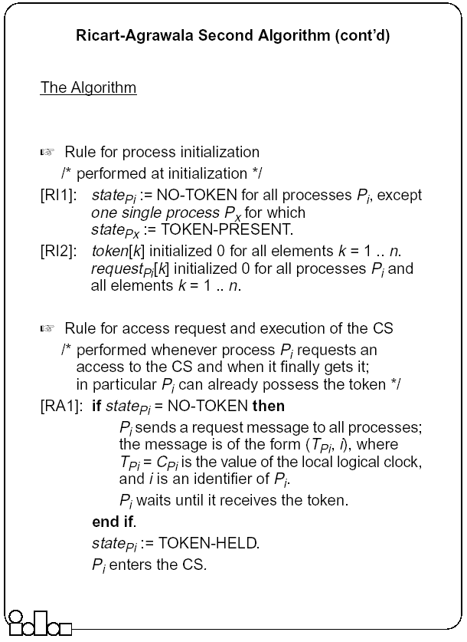

Slide 38
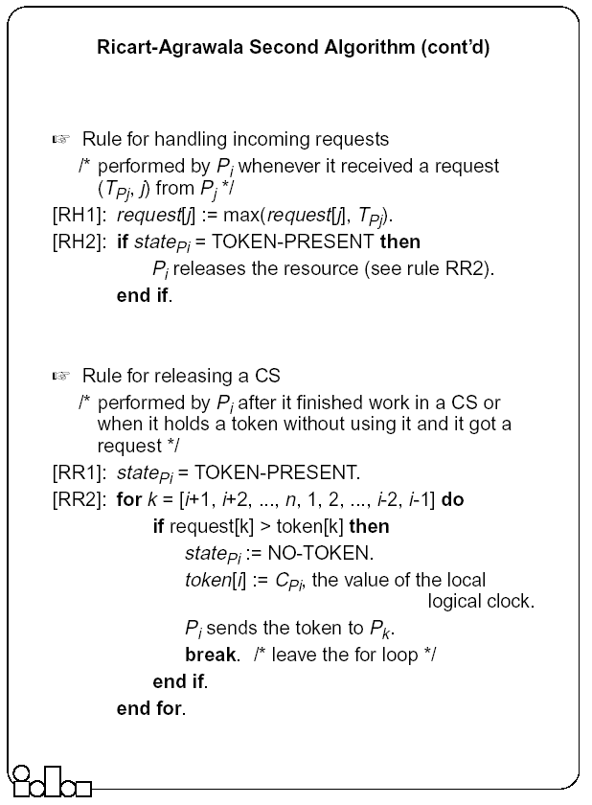

Slide 39
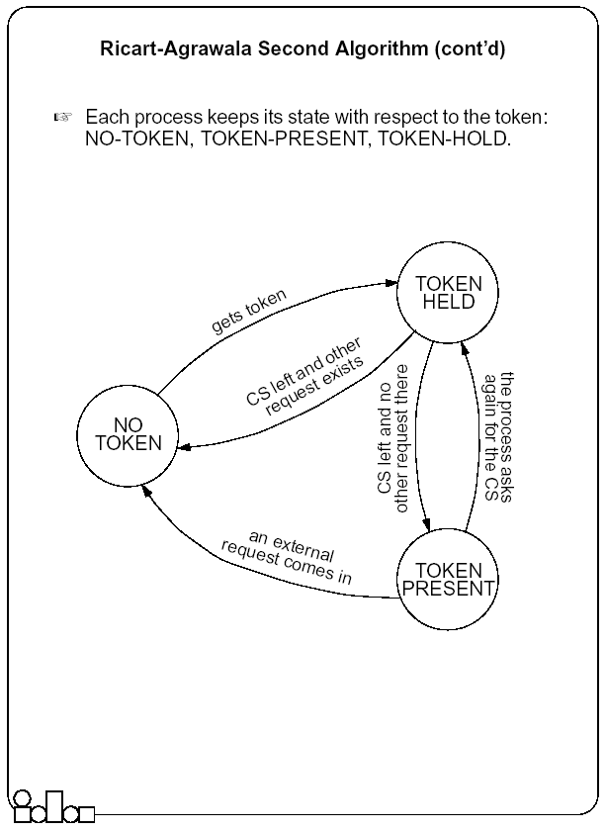

Slide 40
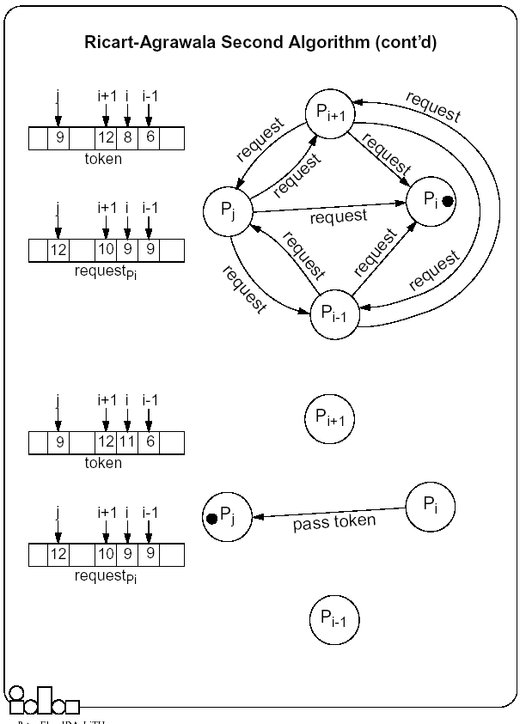

Slide 41
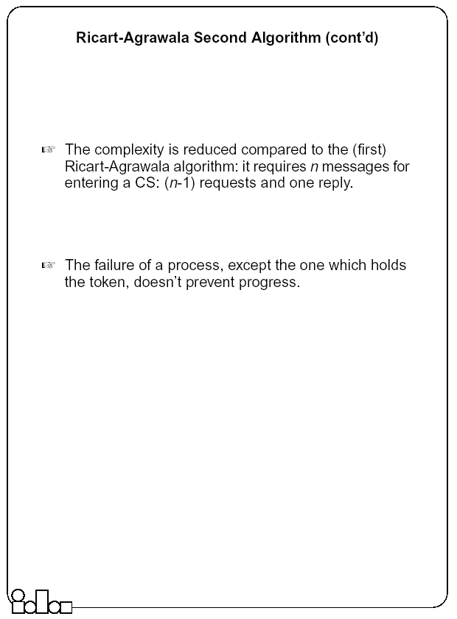

Slide 42
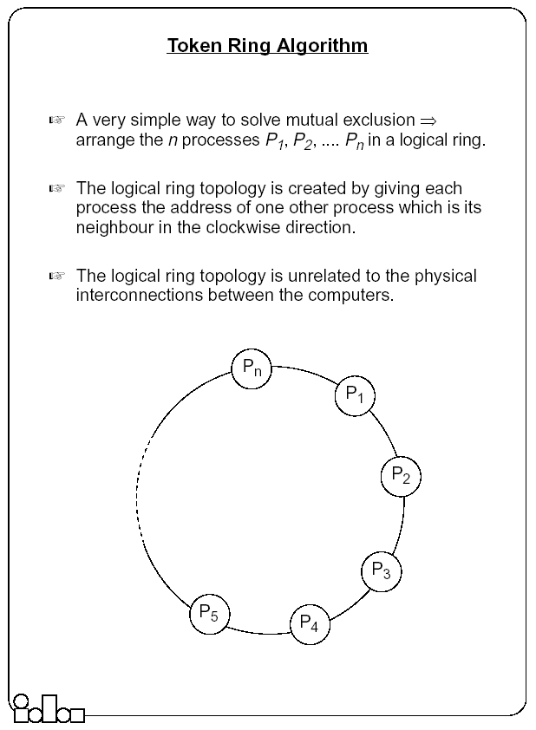

Slide 43
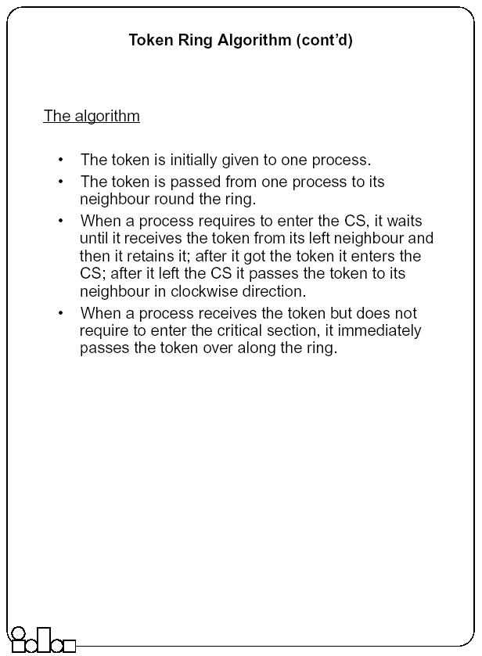

Slide 44
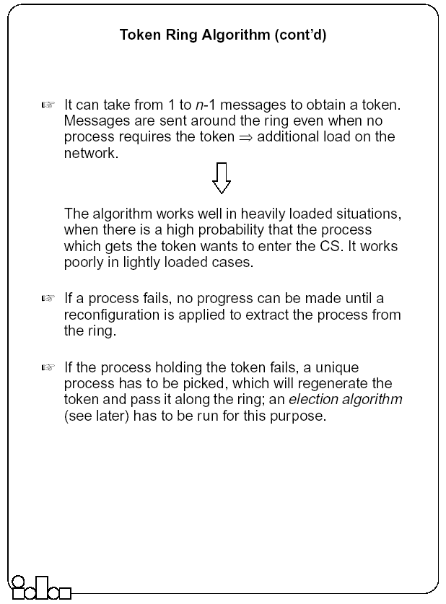

Slide 45
Election Algorithms
Many distributed algorithms require one process to act as a coordinator or, in general, perform some special role.
Examples with mutual exclusion
  Central coordinator algorithm
    At initialization or whenever the coordinator crashes, a new coordinator has to be elected.
  Token ring algorithm
    When the process holding the token fails, a new process has to be elected which generates the new token.

Slide 46
Election Algorithms
It doesn’t matter which process is elected.
  What is important is that one and only one process is chosen (we call this process the coordinator) and all processes agree on this decision.
Assume that each process has a unique number (identifier).
  In general, election algorithms attempt to locate the process with the highest number, among those which currently are up.
Election is typically started after a failure occurs.
  The detection of a failure (e.g. the crash of the current coordinator) is normally based on time-out → a process that gets no response for a period of time suspects a failure and initiates an election process.
An election process is typically performed in two phases:
  Select a leader with the highest priority.
  Inform all processes about the winner.

Slide 47
The Bully Algorithm
A process has to know the identifier of all other processes
  (it doesn’t know, however, which one is still up); the process with the highest identifier, among those which are up, is selected.
Any process could fail during the election procedure.
When a process Pi detects a failure and a coordinator has to be elected
  It sends an election message to all the processes with a higher identifier and then waits for an answer message:
  If no response arrives within a time limit
    Pi becomes the coordinator (all processes with higher identifier are down)
    it broadcasts a coordinator message to all processes to let them know.
  If an answer message arrives,
    Pi knows that another process has to become the coordinator → it waits in order to receive the coordinator message.
    If this message fails to arrive within a time limit (which means that a potential coordinator crashed after sending the answer message) Pi resends the election message.
When receiving an election message from Pi
  a process Pj replies with an answer message to Pi and
  then starts an election procedure itself( unless it has already started one) it sends an election message to all processes with higher identifier.
Finally all processes get an answer message, except the one which becomes the coordinator.

Slide 48
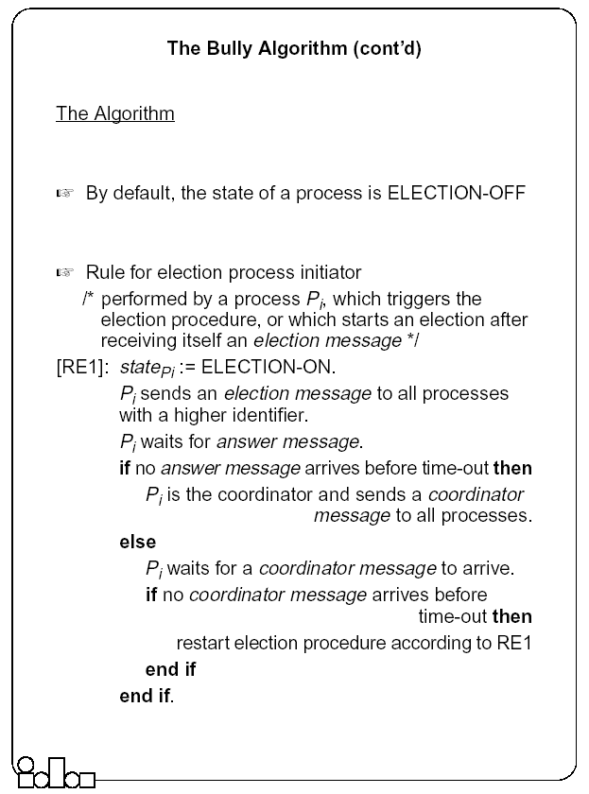

Slide 49
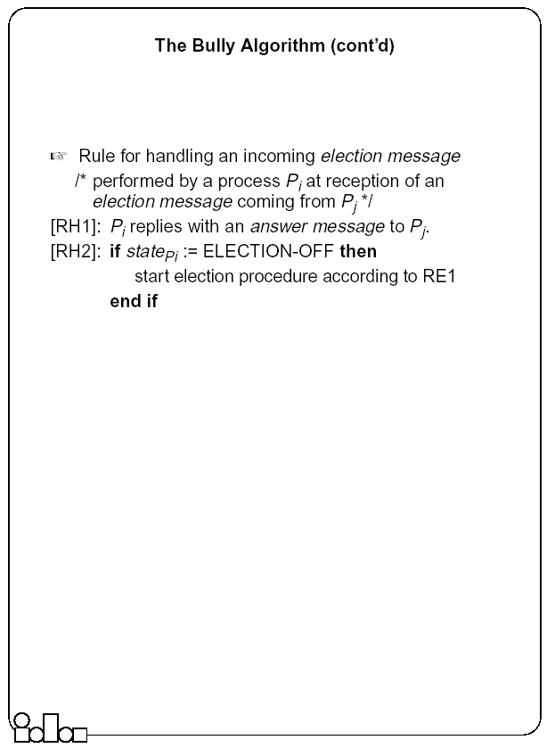

Slide 50
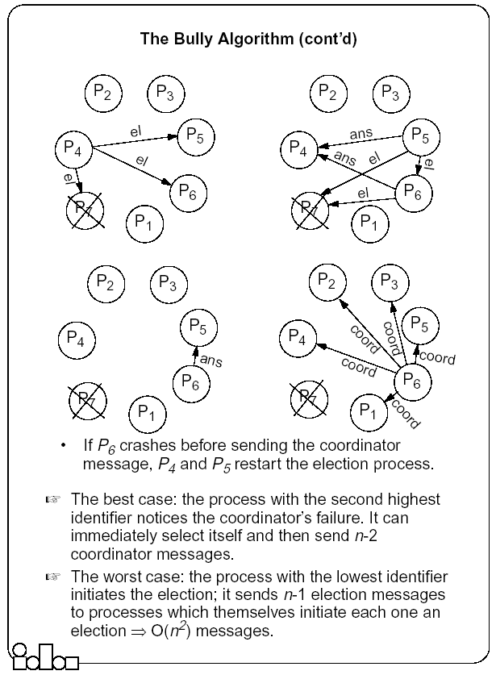

Slide 51
The Ring-based Algorithm
We assume that the processes are arranged in a logical ring
    Each process knows the address of one other process, which is its neighbor in the clockwise direction.
The algorithm elects a single coordinator, which is the process with the highest identifier.
Election is started by a process which has noticed that the current coordinator has failed.
  The process places its identifier in an election message that is passed to the following process.
  When a process receives an election message
    It compares the identifier in the message with its own.
    If the arrived identifier is greater, it forwards the received election message to its neighbor
    If the arrived identifier is smaller it substitutes its own identifier in the election message before forwarding it.
    If the received identifier is that of the receiver itself → this will be the coordinator.
The new coordinator sends an elected message through the ring.

Slide 52
The Ring-based Algorithm- An Optimization
Several elections can be active at the same time.
    Messages generated by later elections should be killed as soon as possible.
Processes can be in one of two states
  Participant or Non-participant.
    Initially, a process is non-participant.
The process initiating an election marks itself participant.
Rules
  For a participant process, if the identifier in the election message is smaller than the own, does not forward any message (it has already forwarded it, or a larger one, as part of another simultaneously ongoing election).
  When forwarding an election message, a process marks itself participant.
  When sending (forwarding) an elected message, a process marks itself non-participant.

Slide 53
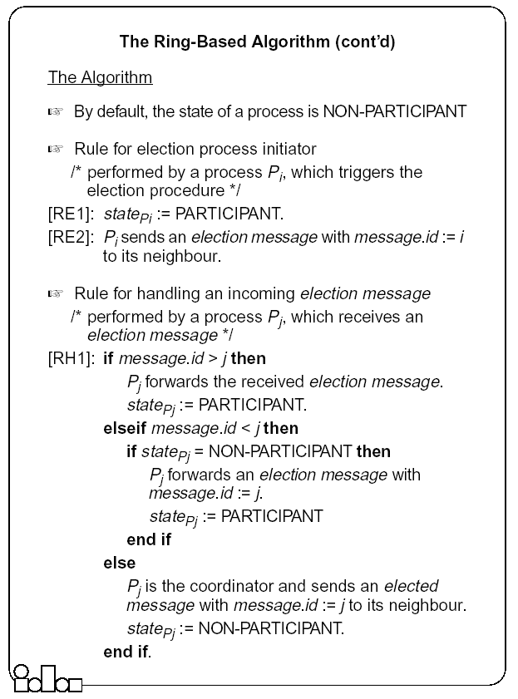

Slide 54
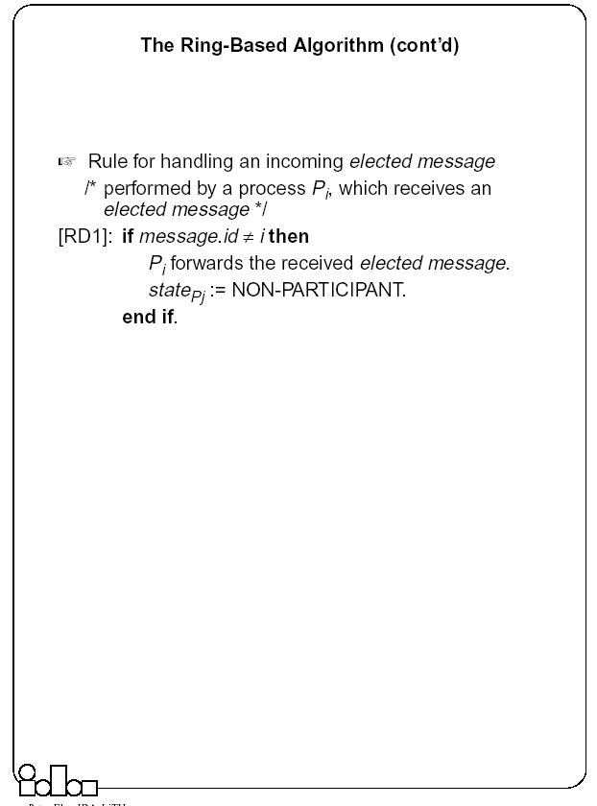

Slide 55
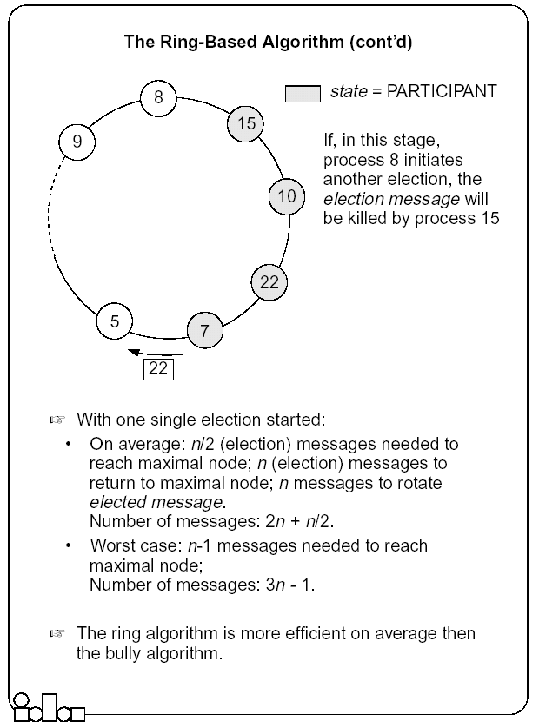

Slide 56
Summary (Distributed Mutual Exclusion)
In a distributed environment no shared variables (semaphores) and local kernels can be used to enforce mutual exclusion. Mutual exclusion has to be based only on message passing.
There are two basic approaches to mutual exclusion: non-token-based and token-based.
The central coordinator algorithm is based on the availability of a coordinator process which handles all the requests and provides exclusive access to the resource. The coordinator is a performance bottleneck and a critical point of failure. However, the number of messages exchanged per use of a CS is small.
The Ricart-Agrawala algorithm is based on fully distributed agreement for mutual exclusion. A request is multicast to all processes competing for a resource and access is provided when all processes have replied to the request. The algorithm is expensive in terms of message traffic, and failure of any process prevents progress.
Ricart-Agrawala’s second algorithm is token-based. Requests are sent to all processes competing for a resource but a reply is expected only from the process holding the token. The complexity in terms of message traffic is reduced compared to the first algorithm. Failure of a process (except the one holding the token) does not prevent progress.

Slide 57
Summary (Distributed Mutual Exclusion)
The token-ring algorithm very simply solves mutual exclusion. It is requested that processes are logically arranged in a ring. The token is permanently passed from one process to the other and the process currently holding the token has exclusive right to the resource. The algorithm is efficient in heavily loaded situations.
For many distributed applications it is needed that one process acts as a coordinator. An election algorithm has to choose one and only one process from a group, to become the coordinator. All group members have to agree on the decision.
The bully algorithm requires the processes to know the identifier of all other processes; the process with the highest identifier, among those which are up, is selected. Processes are allowed to fail during the election procedure.
The ring-based algorithm requires processes to be arranged in a logical ring. The process with the highest identifier is selected. On average, the ring based algorithm is more efficient then the bully algorithm.

Slide 58
Deadlocks
Mutual exclusion, hold-and-wait, No-preemption and circular wait.
Deadlocks can be modeled using resource allocation graphs
Handling Deadlocks
  Avoidance (requires advance knowledge of processes and their resource requirements)
  Prevention (collective/ordered requests, preemption)
  Detection and recovery (local/global WFGs, local/centralized deadlock detectors; Recovery by operator intervention, termination and rollback)

Slide 59
Distributed Process and Resource Management
Need multiple policies to determine when and where to execute processes in distributed systems – useful for load balancing, reliability
  Load Estimation Policy
    How to estimate the workload of a node
  Process Transfer Policy
    Whether to execute a process locally or remotely
  Location Policy
    Which node to run the remote process on
  Priority Assignment Policy
    Which processes have more priority (local or remote)
  Migration Limiting policy
    Number of times a process can migrate

Slide 60
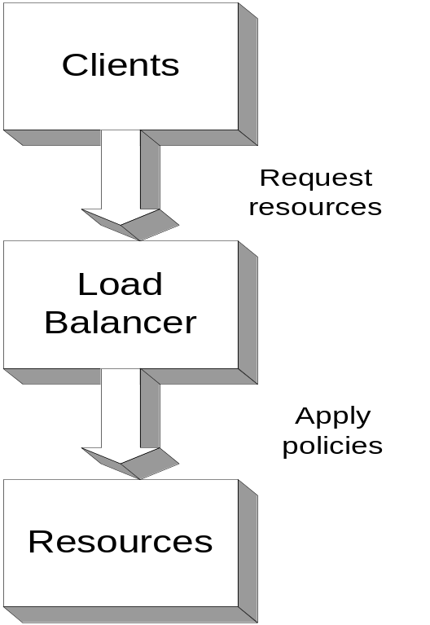
Load Balancing
Computer overloaded
  Decrease load maintain scalability, performance, throughput - transparently
  Load Balancing
    Can be thought of as “distributed scheduling”
      Deals with distribution of processes among processors connected by a network
    Can also be influenced by “distributed placement”
      Especially in data intensive applications
  Load Balancer
  Manages resources
  Policy driven Resource assignment
Global Distributed Systems and Multimedia

Slide 61
Load Balancingn(cont.)
Static load balancing - CPU determined at process creation.
Dynamic load balancing - processes dynamically migrate to other computers to balance the CPU (or memory) load.
    Parallel machines - dynamic balancing schemes seek to minimize total execution time of a single application running in parallel on a multiple nodes
    Web servers - scheduling client requests among multiple nodes in a transparent way to improve response times for interaction
    Multimedia servers - resource optimization across streams and servers for QoS; may require admission control

Slide 62
Process Migration
Process migration mechanism
  Freeze the process on the source node and restart it at the destination node
  Transfer of the process address space
  Forwarding messages meant for the migrant process
  Handling communication between cooperating processes separated as a result of migration
  Handling child processes
Migration architectures
  One image system
  Point of entrance dependent system (the deputy concept)

Slide 63

A Mosix Cluster
Mosix (from Hebrew U): Kernel level enhancement to Linux that provides dynamic load balancing in a network of workstations.
Dozens of PC computers connected by local area network (Fast-Ethernet or Myrinet).
Any process can migrate anywhere anytime.

Slide 64
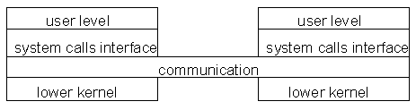
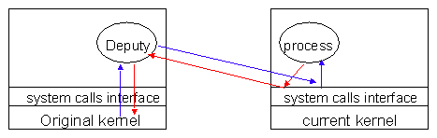
Architectures for Migration
Architecture that fits one system image.
Needs location transparent file system.
(Mosix early versions)
Architecture that fits entrance dependant systems.
Easier to implement based on current Unix.
(Mosix later versions)

Slide 65
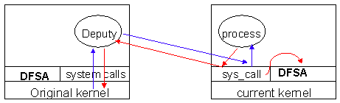
Mosix: Migration and File Access
Each file access must go back to deputy…
= = Very Slow for I/O apps.
Solution: Allow processes to access a distributed file system through the current kernel.

Slide 66
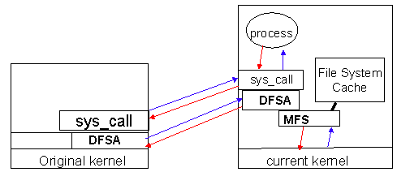
Mosix: File Access
DFSA
  Requirements (cache coherent, monotonic timestamps, files not deleted until all nodes finished)
  Bring the process to the files.
MFS
  Single cache (on server)
  /mfs/1405/var/tmp/myfiles

Slide 67
Process Migration: Other Factors
Not only CPU load!!!
Memory.
I/O - where is the physical device?
Communication - which processes communicate with which other processes?

Slide 68
Process Migration and Heterogeneous Systems
Converts usage of heterogeneous resources (CPU, memory, IO) into a single, homogeneous cost using a specific cost function.
Assigns/migrates a job to the machine on which it incurs the lowest cost.
  Can design online job assignment policies based on multiple factors - economic principles, competitive analysis.
  Aim to guarantee near-optimal global lower-bound performance.

Slide 69
Distributed File Systems (DFS)
A distributed implementation of the classical file system model
Requirements
  Transparency: Access, Location, Mobility, Performance, Scaling
  Allow concurrent access
  Allow file replication
  Tolerate hardware and operating system heterogeneity
  Security - Access control, User authentication
Issues
  File and directory naming – Locating the file
  Semantics – client/server operations, file sharing
  Performance
  Fault tolerance – Deal with remote server failures
  Implementation considerations - caching, replication, update protocols

Slide 70
Issues: File and Directory Naming
Explicit Naming
  Machine + path /machine/path
    one namespace but not transparent
Implicit naming
  Location transparency
    file name does not include name of the server where the file is stored
  Mounting remote filesystems onto the local file hierarchy
    view of the filesystem may be different at each computer
  Full naming transparency
    A single namespace that looks the same on all machines

Slide 71
Semantics - Operational
Support fault tolerant operation
  At-most-once semantics for file operations
  At-least-once semantics with a server protocol designed in terms of idempotent file operations
  Replication (stateless, so that servers can be restarted after failure)

Slide 72
Semantics – File Sharing
  One-copy semantics
    Updates are written to the single copy and are available immediately
    all clients see contents of file identically as if only one copy of file existed
    if caching is used: after an update operation, no program can observe a discrepancy between data in cache and stored data
  Serializability
    Transaction semantics (file locking protocols implemented - share for read, exclusive for write).
  Session semantics
    Copy file on open, work on local copy and copy back on close

Slide 73
DFS Performance
Efficiency Needs
  Latency of file accesses
  Scalability (e.g., with increase of number of concurrent users)
RPC Related Issues
  Use RPC to forward every file system request (e.g., open, seek, read, write, close, etc.) to the remote server
    Remote server executes each operation as a local request
    Remote server responds back with the result
  Advantage:
    Server provides a consistent view of the file system to distributed clients.
  Disadvantage:
    Poor performance
    Solution: Caching

Slide 74
Traditional File system Operations
filedes = open(name, mode) Opens an existing file with the given name.
filedes = creat(name, mode) Creates a new file with the given name.
Both operations deliver a file descriptor referencing the open file. The mode is read, write or both.
status = close(filedes) Closes the open file filedes.
count = read(filedes, buffer, n) Transfers n bytes from the file referenced by filedes to buffer.
count = write(filedes, buffer, n) Transfers n bytes to the file referenced by filedes from buffer.
Both operations deliver the number of bytes actually transferred and advance the read-write pointer.
pos = lseek(filedes, offset, whence) Moves the read-write pointer to offset (relative or absolute, depending on whence).
status = unlink(name) Removes the file name from the directory structure. If the file has no other names, it is deleted.
status = link(name1, name2) Adds a new name (name2) for a file (name1).
status = stat(name, buffer) Gets the file attributes for file name into buffer.

Slide 75
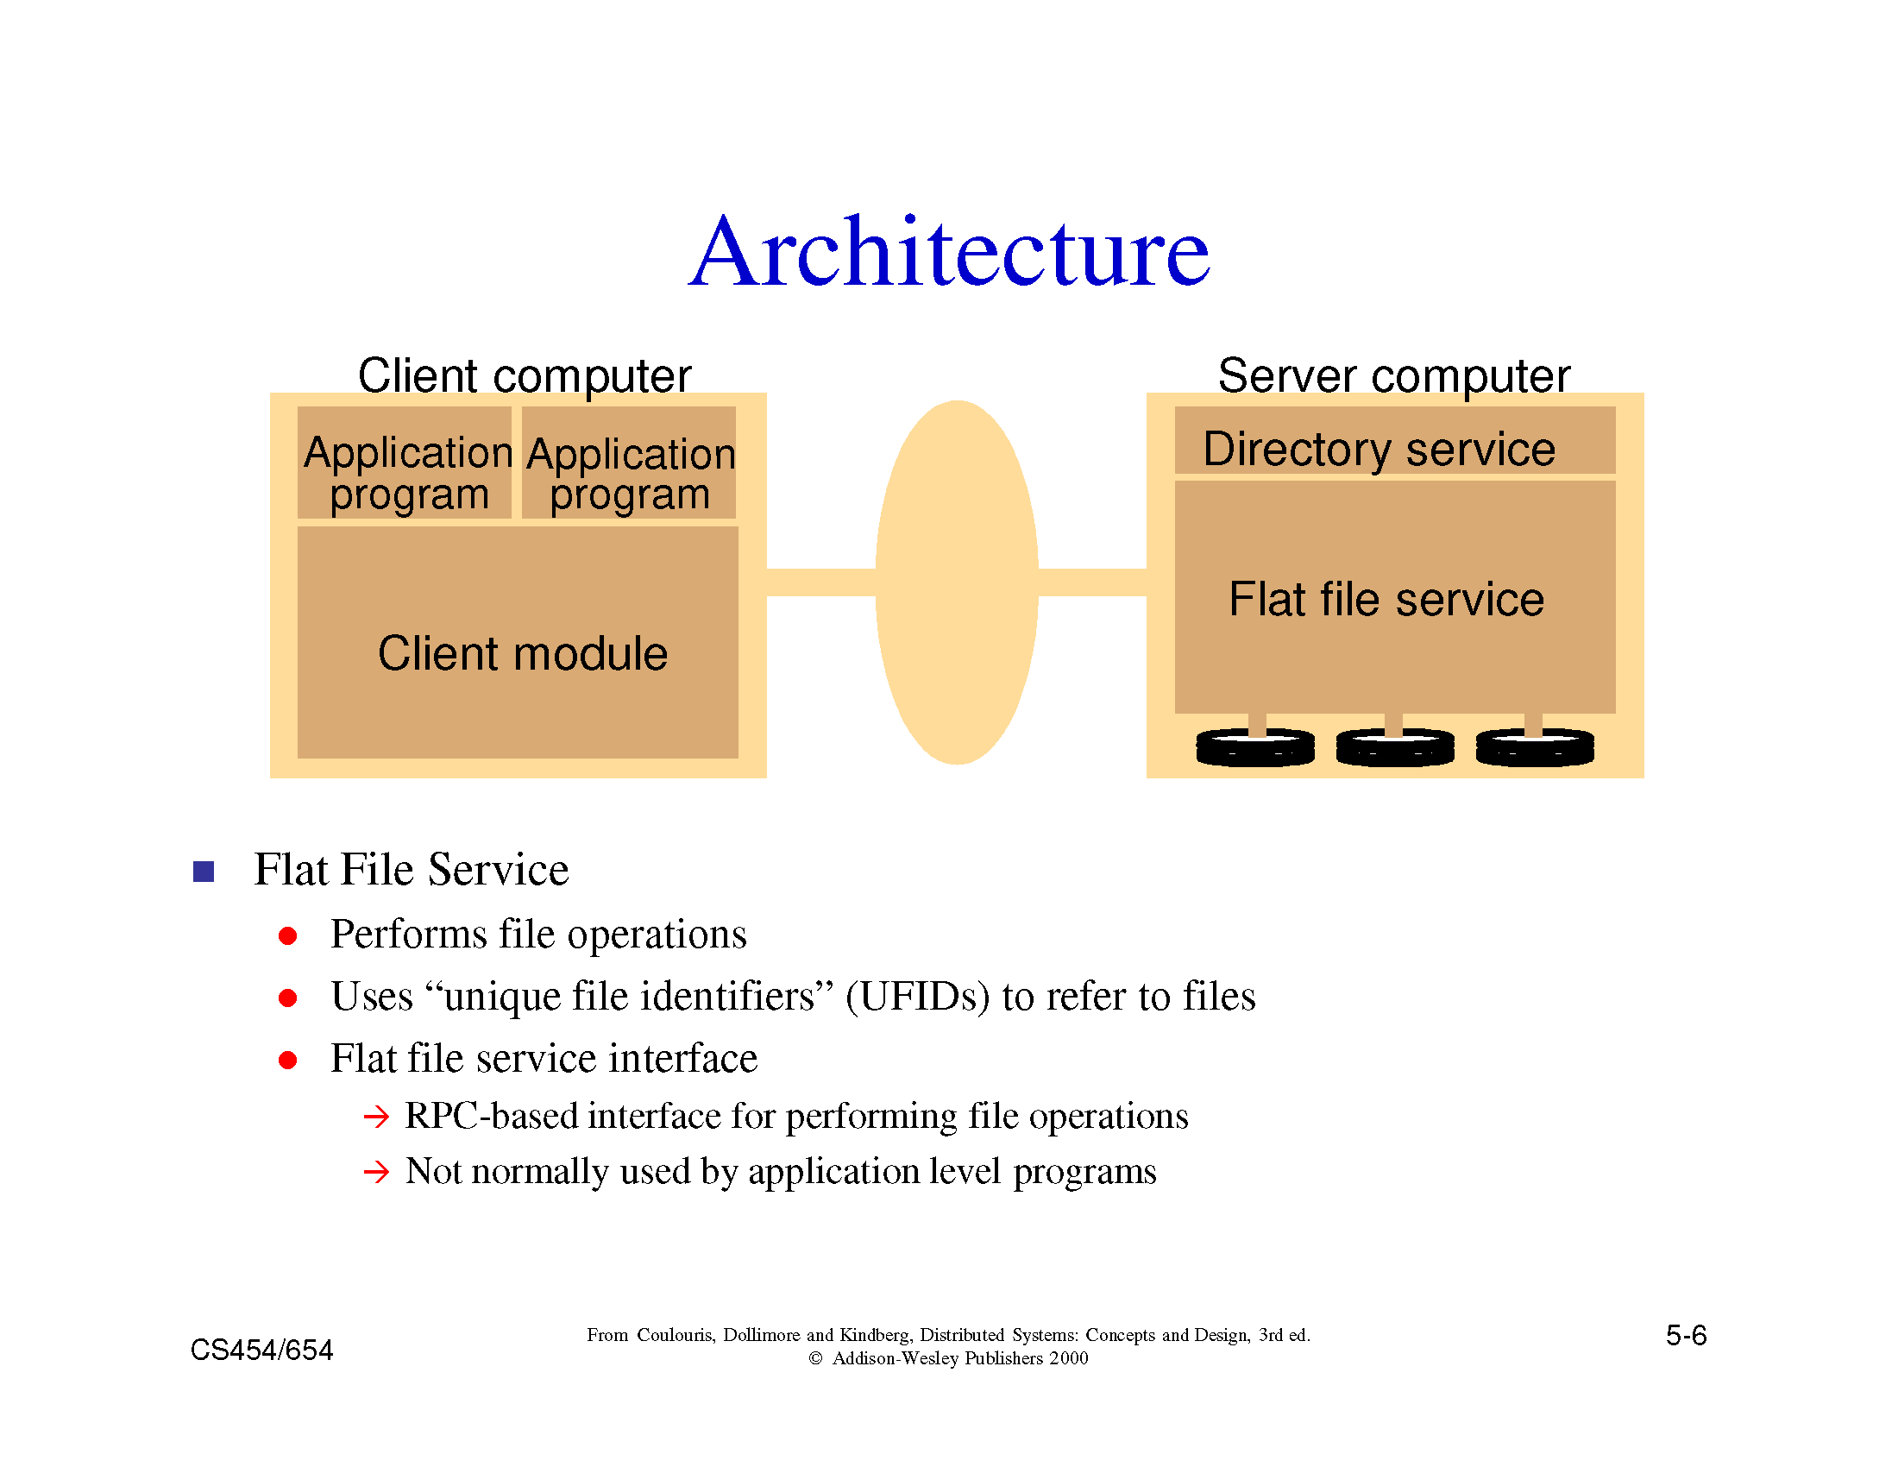

Slide 76
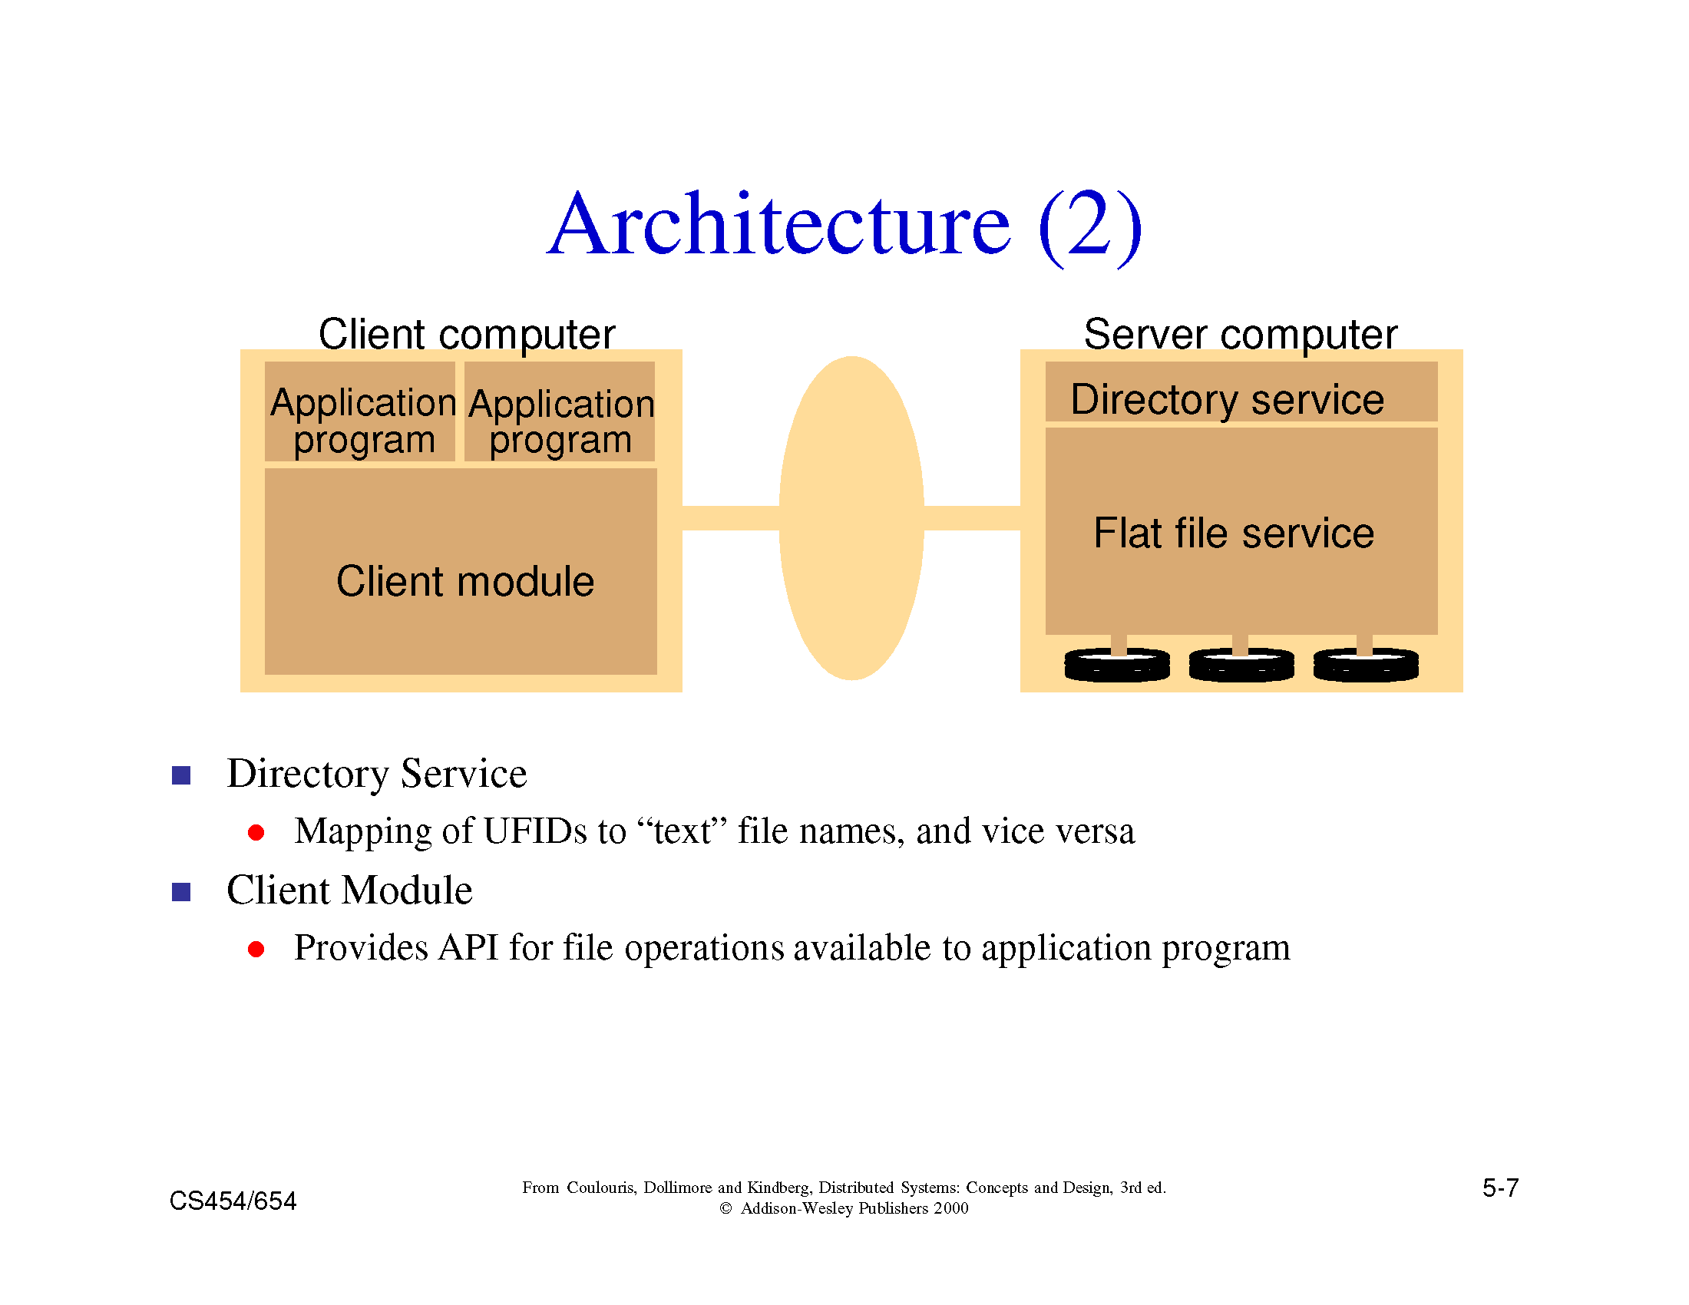

Slide 77
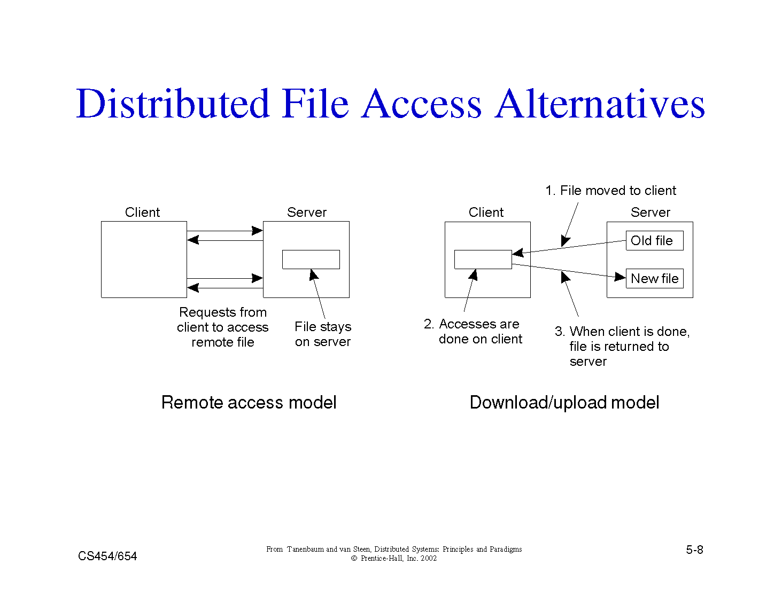

Slide 78
Example 1: Sun-NFS
Supports heterogeneous systems
  Architecture
    Server exports one or more directory trees for access by remote clients
    Clients access exported directory trees by mounting them to the client local tree
    Diskless clients mount exported directory to the root directory
  Protocols
    Mounting protocol
    Directory and file access protocol - stateless, no open-close messages, full access path on read/write
  Semantics - no way to lock files

Slide 79
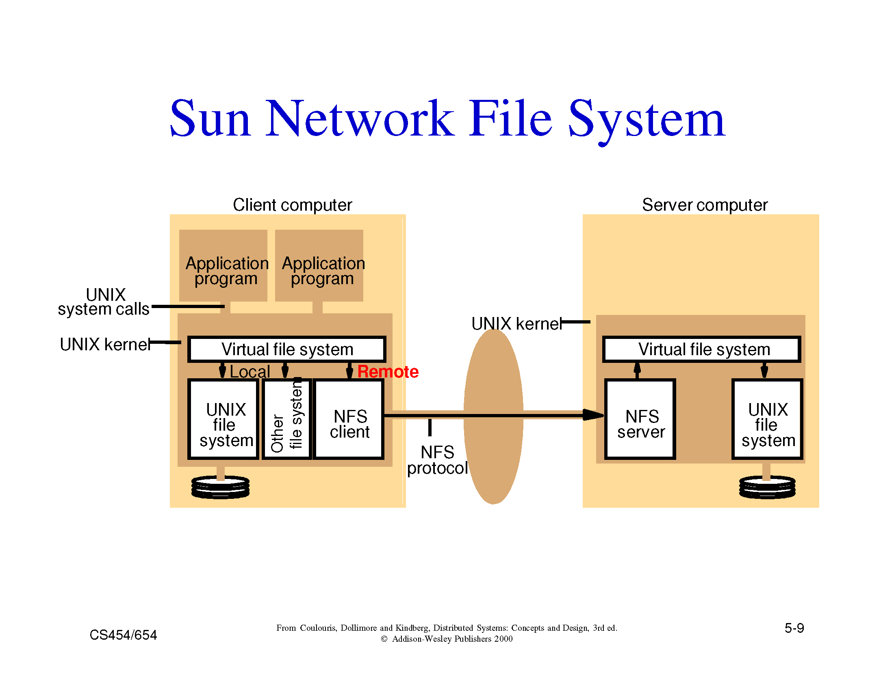

Slide 80
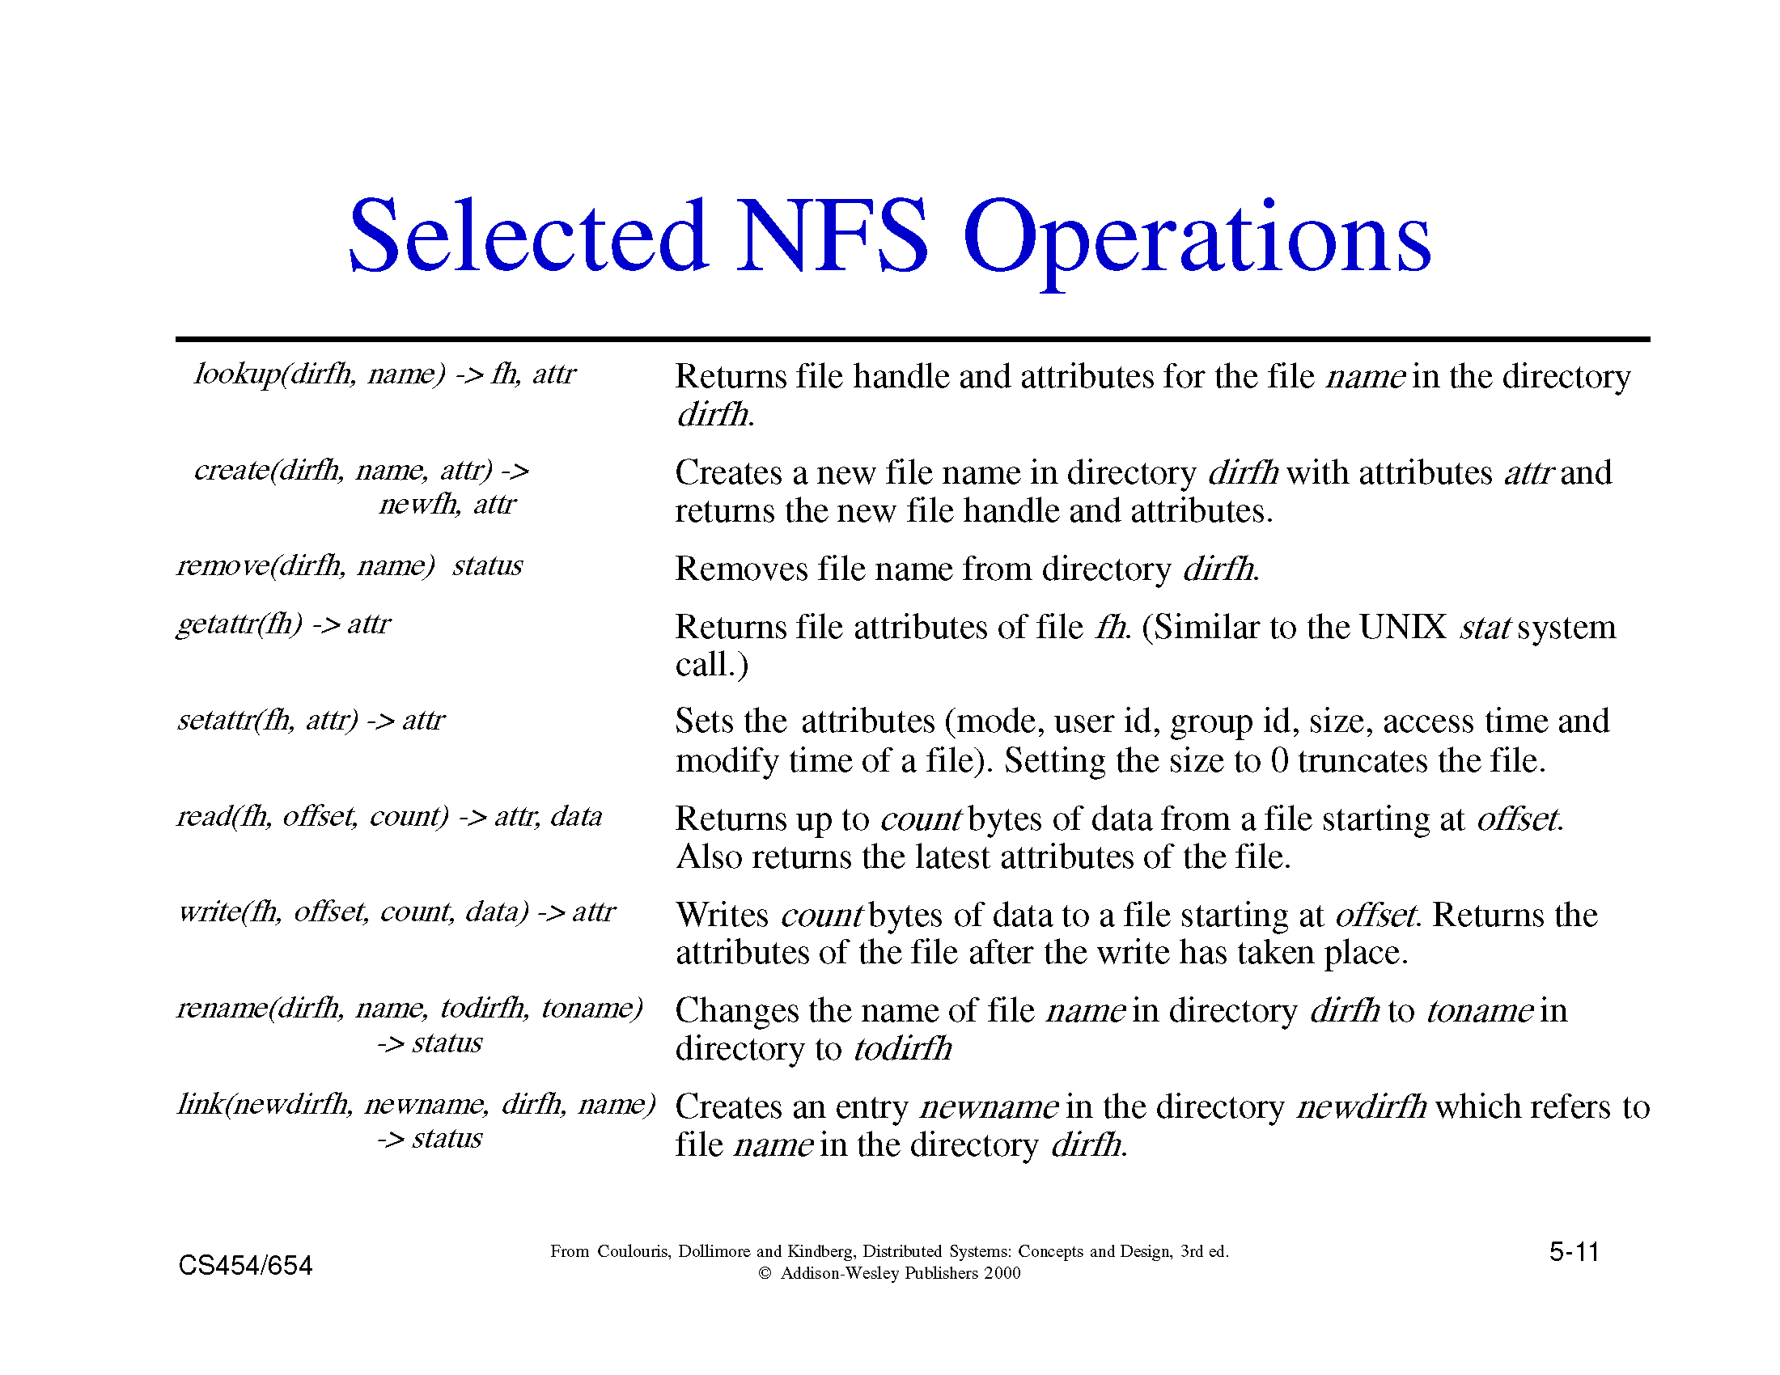

Slide 81
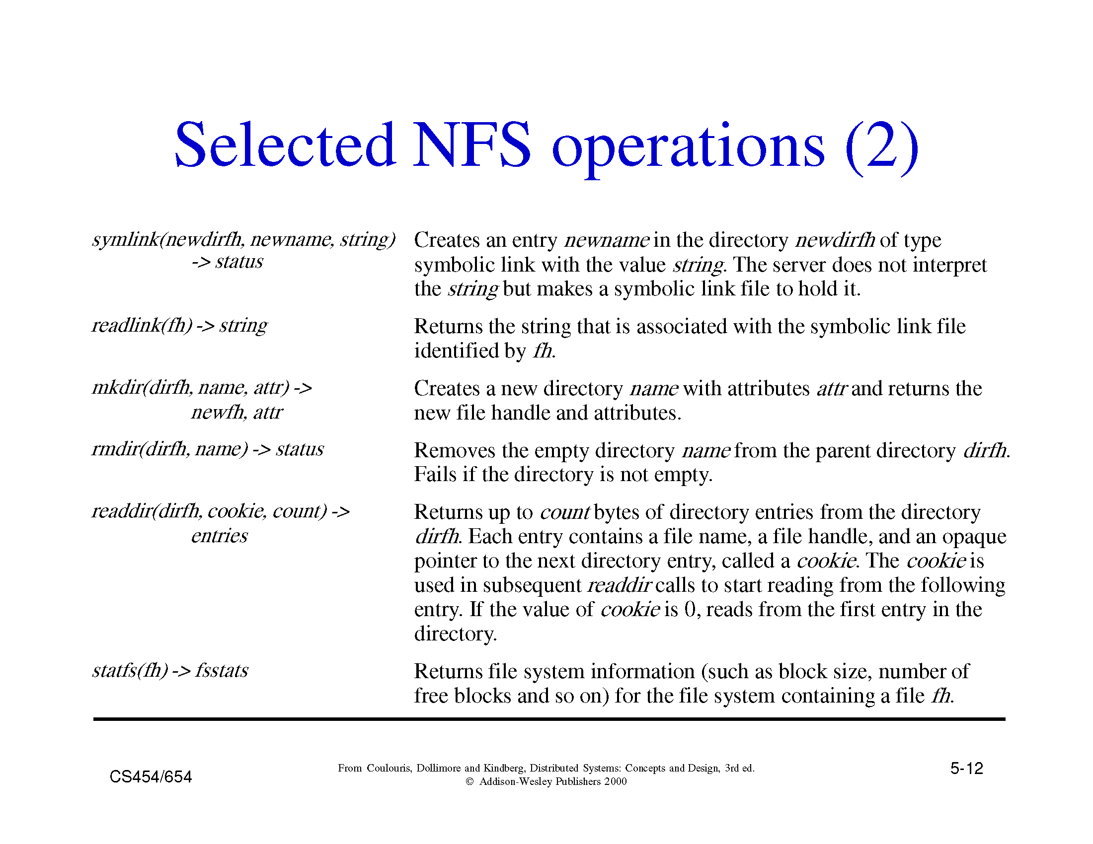

Slide 82
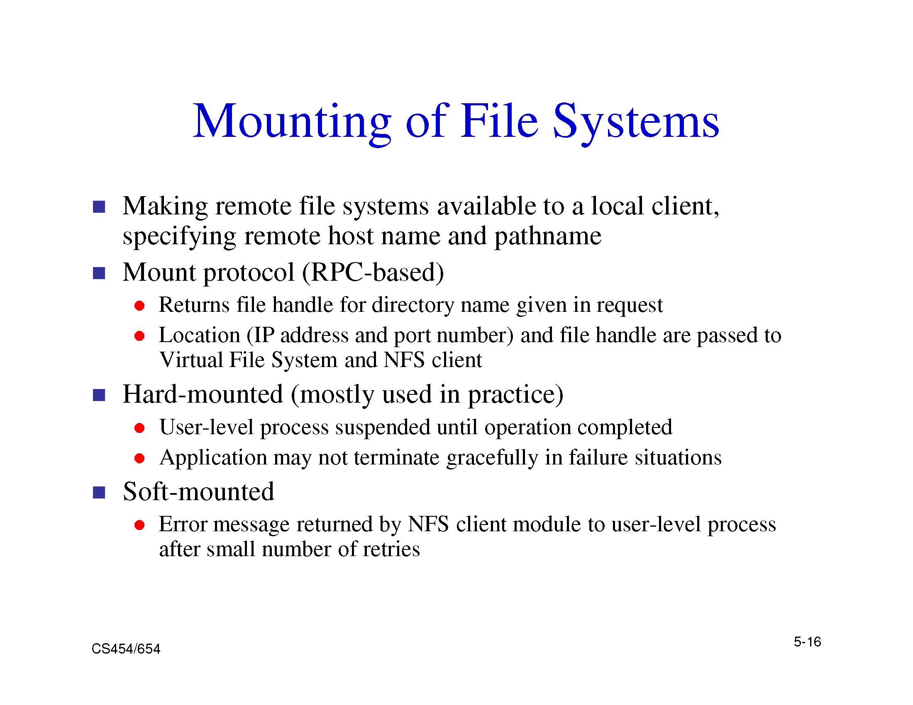

Slide 83
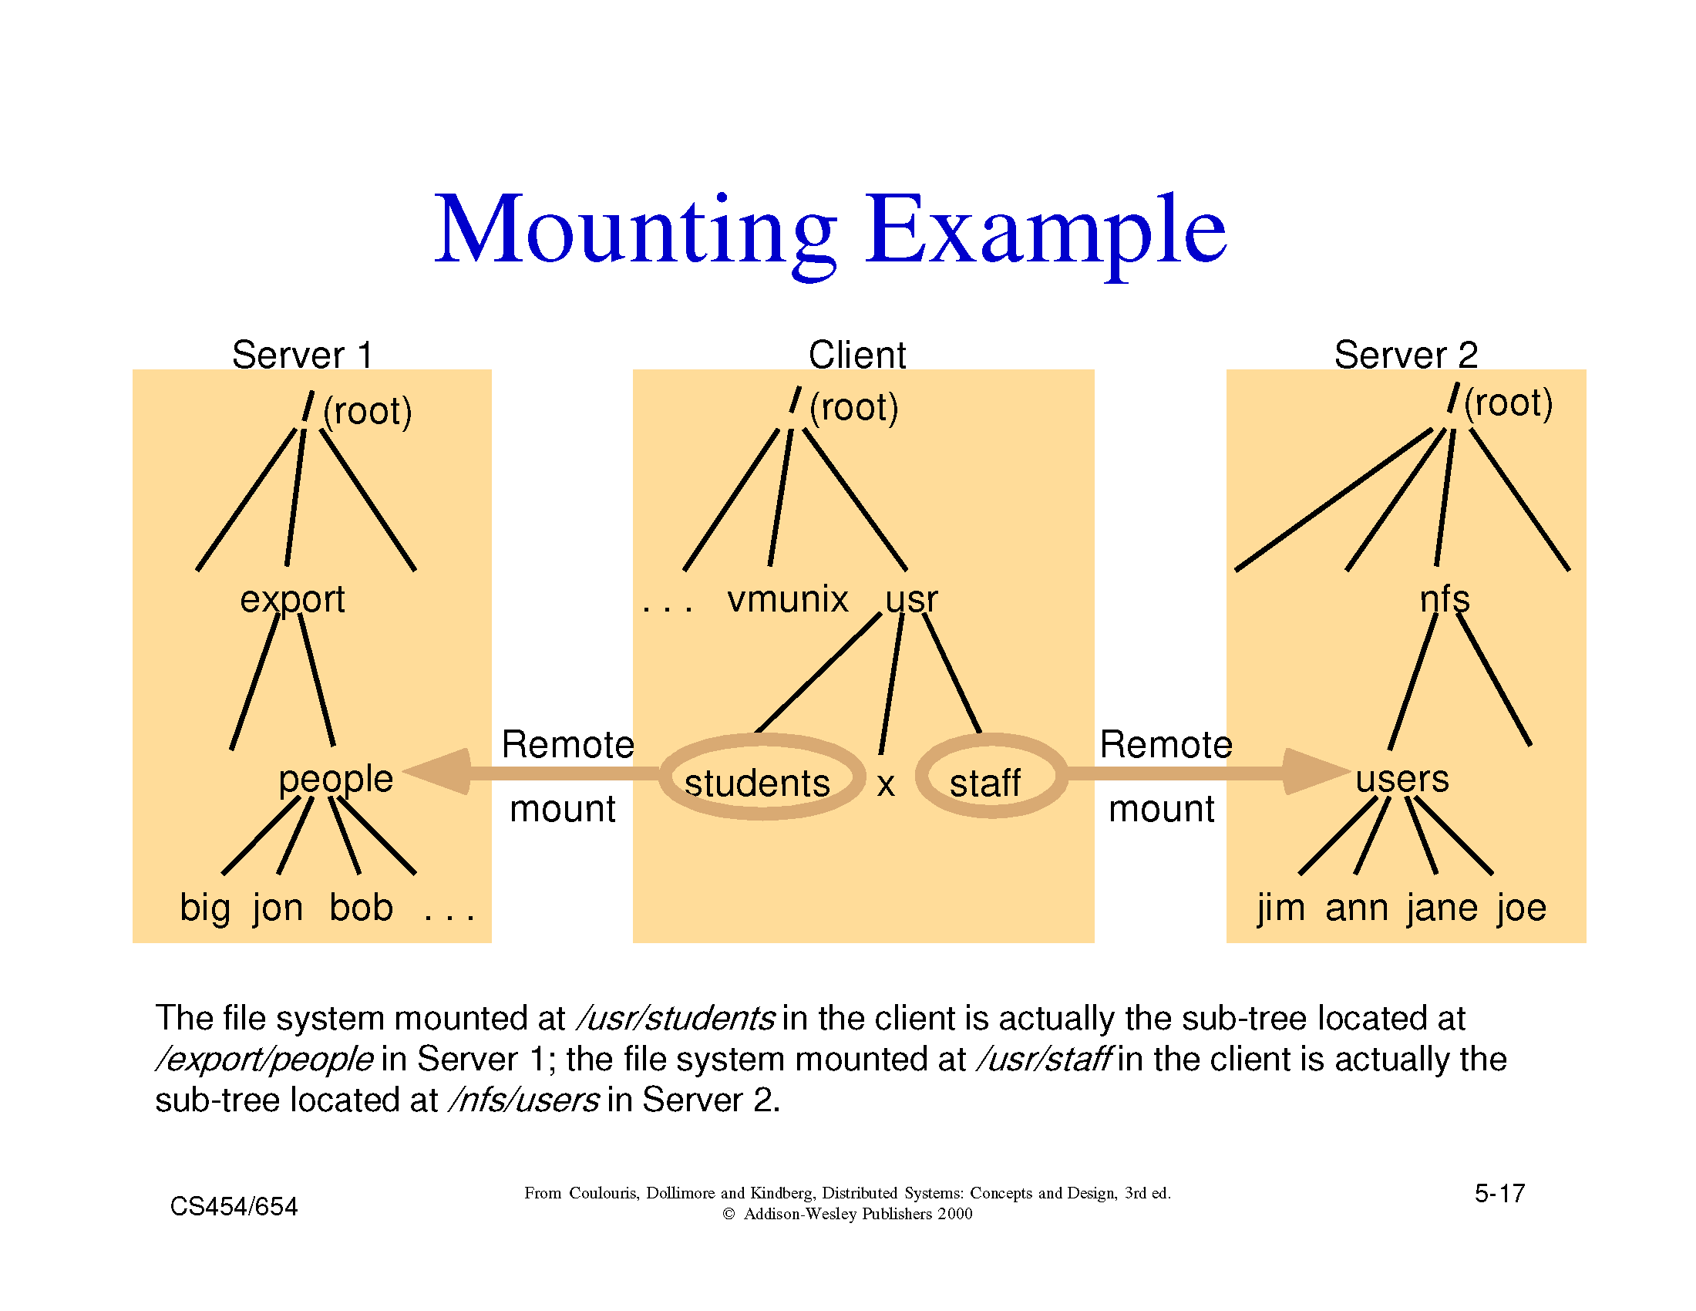

Slide 84
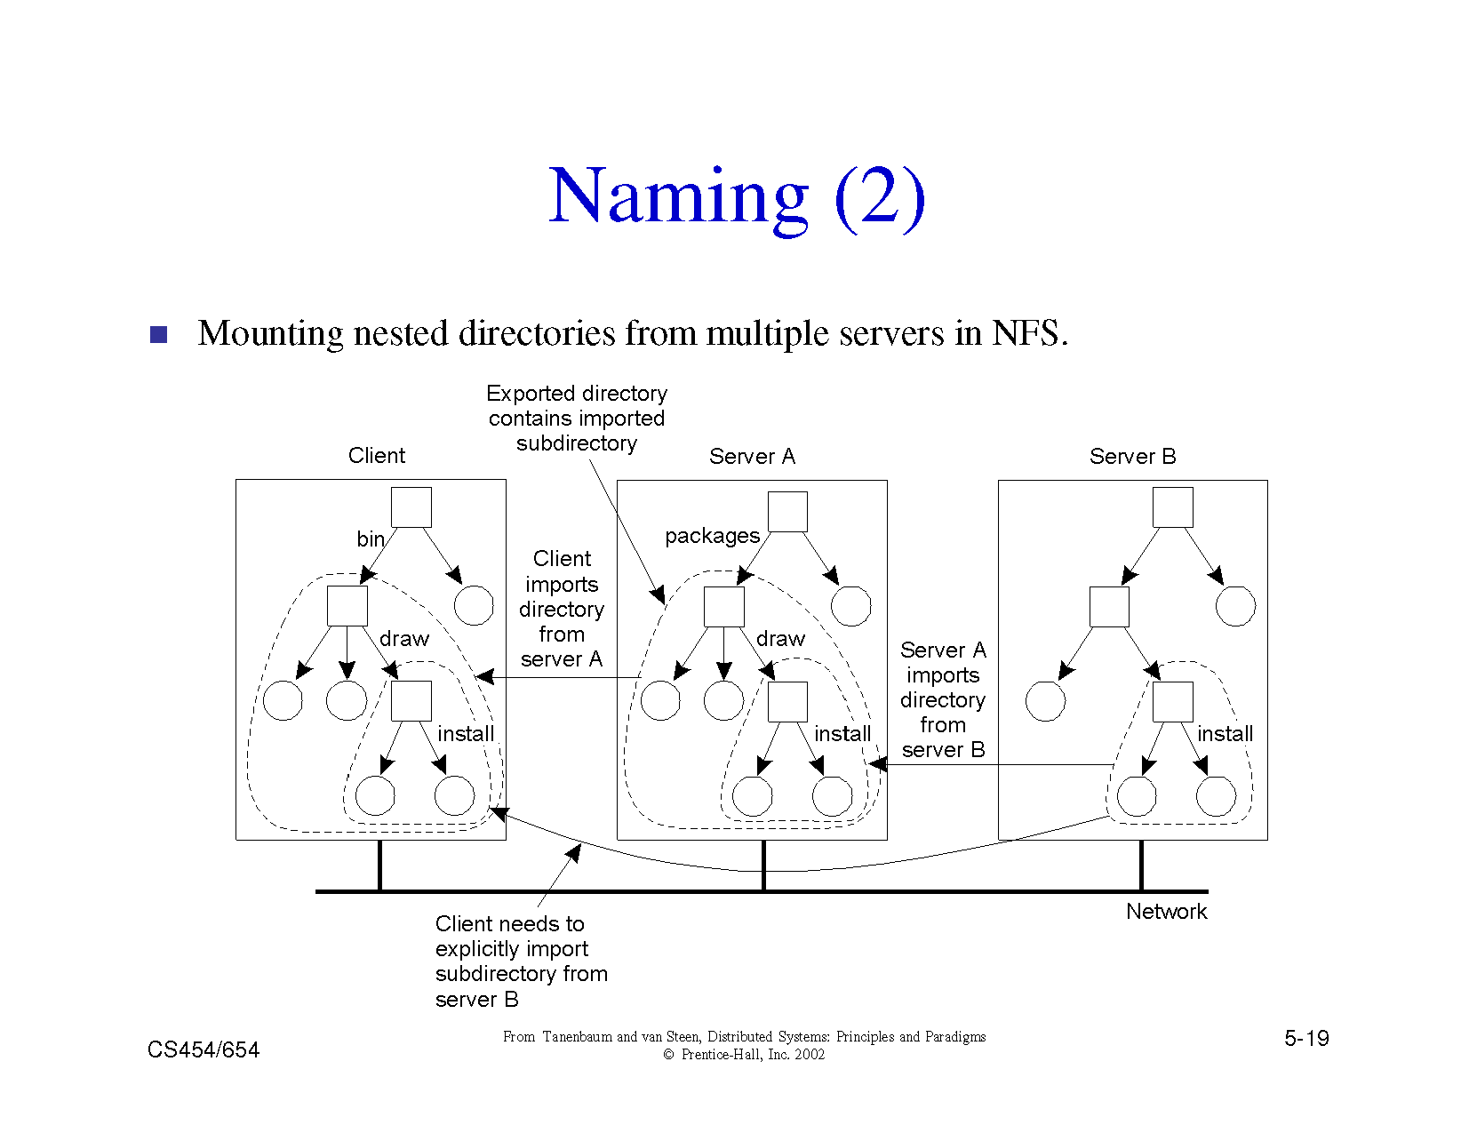

Slide 85
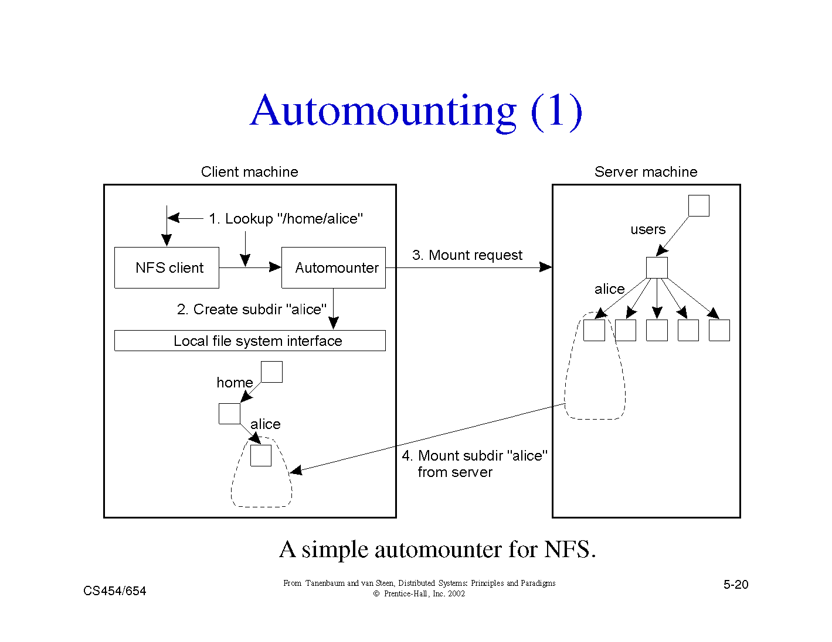

Slide 86
Example 2: Andrew File System
Supports information sharing on a large scale
Uses a session semantics
  Entire file is copied to the local machine (Venus) from the server (Vice) when open. If file is changed, it is copied to server when closed.
    Works because in practice, most files are changed by one person
AFS File Validation (older versions)
  On open: Venus accesses Vice to see if its copy of the file is still valid. Causes a substantial delay even if the copy is valid.
  Vice is stateless

Slide 87
Example 3: The Coda Filesystem
Descendant of AFS that is substantially more resilient to server and network failures.
General Design Principles
  know the clients have cycles to burn, cache whenever possible, exploit usage properties, minimize system wide change, trust the fewest possible entries and batch if possible
Directories are replicated in several servers (Vice)
Support for mobile users
  When the Venus is disconnected, it uses local versions of files. When Venus reconnects, it reintegrates using optimistic update scheme.

Slide 88
Other DFS Challenges
Naming
  Important for achieving location transparency
  Facilitates Object Sharing
  Mapping is performed using directories. Therefore name service is also known as Directory Service
Security
  Client-Server model makes security difficult
  Cryptography based solutions

